Slide 1

Placement Management System
Present & Designed By :
Gunjan Balpande
Dhanshree Lokhande
Harshada Gunjal
Ragini Patil
Mayuri Waghmare
Anuradha Borpe
Guided By:
Jayant V.
Batch :
2021 – 5732
PUNE

Slide 2
OUTLINE
Introduction
Objective
Software Requirement
Output

Slide 3
INTRODUCTION
Our project explains about the Placement Management System. This project is developed as an attempt to take a record of a company and students by restricting such a large database to that of a particular class of a student or company. The system provides the facility of viewing both the personal and academic information of the student and company, it can also search eligible students and company and also insertion and deletion of a records by admin.
Our Project Include following Modules :
Admin Module
Student Module.
In our project we used MVC Architecture. For implementing view layer we used HTML, CSS, JSP, BootStrap. With the help of these languages we created our User Interface and also we added validation in our project with the help of these languages. For implementing Logic Layer i.e Controller Layer we used Servlet concept. In this layer we used front controller design pattern and we have created separate servlet to take request and perform action on that request it takes user input. For implementing Database layer i.e Model Layer we used Hibernate. This layer is responsible for executing Business Logic.

Slide 4
The key feature of this project is that it is a onetime registration. Our project provides the facility of maintaining the details of the students. Admin logging in may also search any information put up by the students. This will also help in fast access procedures in placement related activities.
Utilities according to specific user :
Admin
Admin has the supreme power of the application.
Admin provides approval for students registration.
Admin is responsible for maintaining the whole system.
Admin can delete any profile.
2. Student
Student is the user if this application.
New student needs to sign up with basic details.
Registered student can login using unique username and password.
Student can update their profile information.

Slide 5
OBJECTIVE
Help in fast access procedure in placement related activities.
The facility of maintaining the details of the students.
Time saving.
Easily finding out the list of eligible students for company training and placement.

Slide 6
SOFTWARE REQUIREMENT
Front end :
Java/J2EE technologies (Servlet, JSP)
HTML
CSS
JavaScript
Bootstrap
Hibernate
Back end :
MySQL workbench 5.0.23CE.
Middleware/Server :
Apache Tomcat v8.5. IDE: Eclipse IDE for Java EE Developers
Browser: Best result on Google Chrome
Operating System: Window 10.

Slide 7
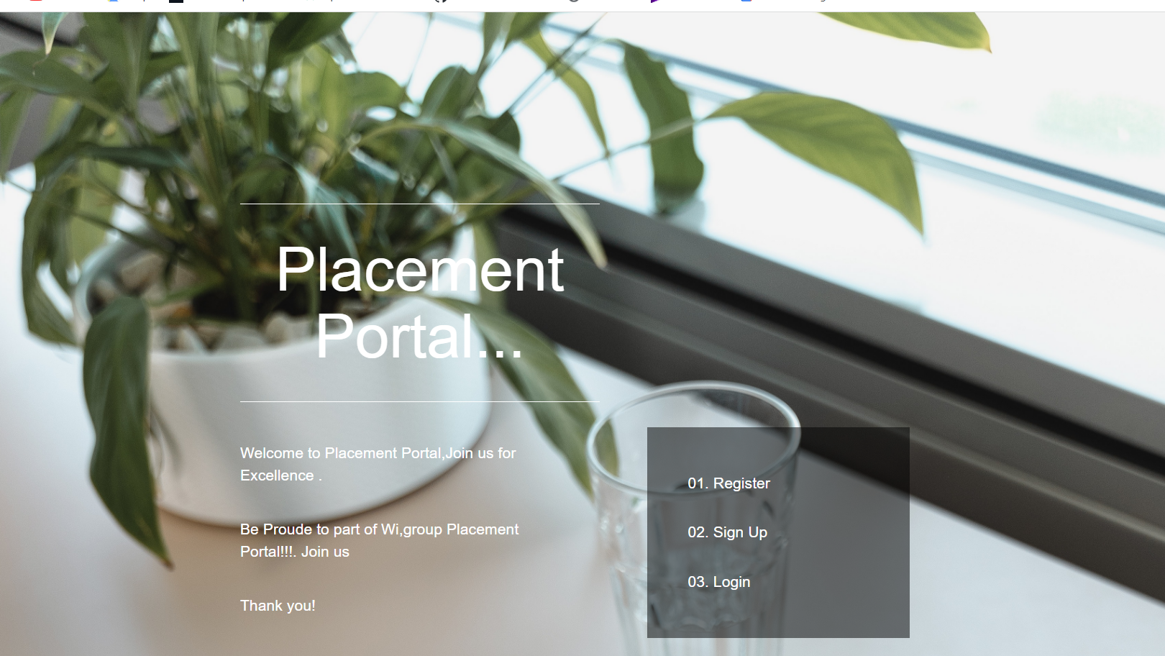
Home

Slide 8
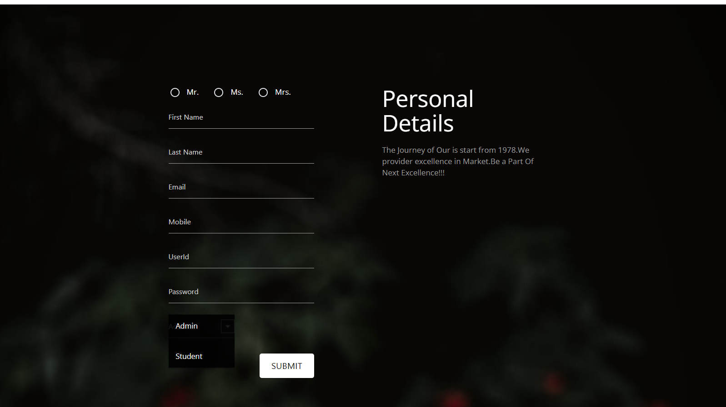
Register

Slide 9
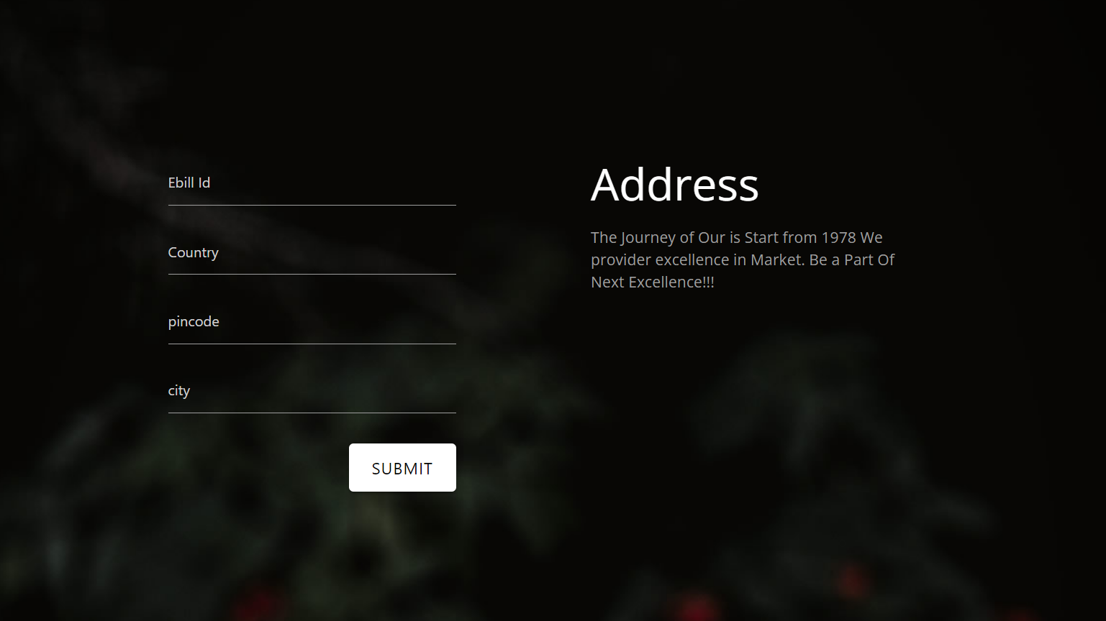
Address

Slide 10

Education Details

Slide 11
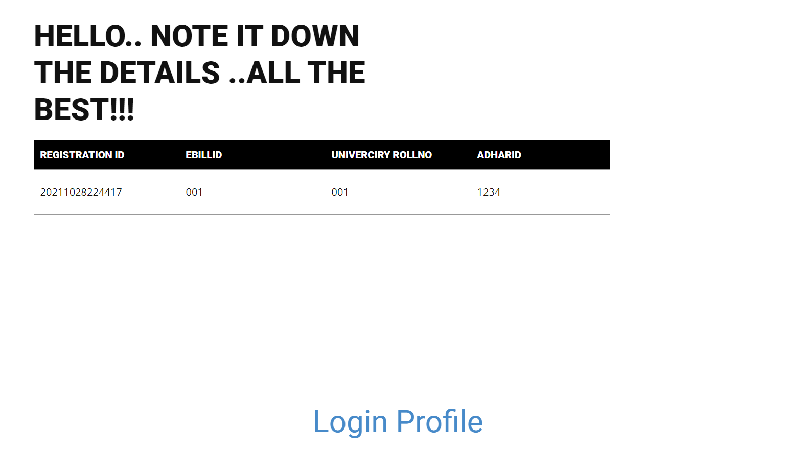
Candidate Detail

Slide 12
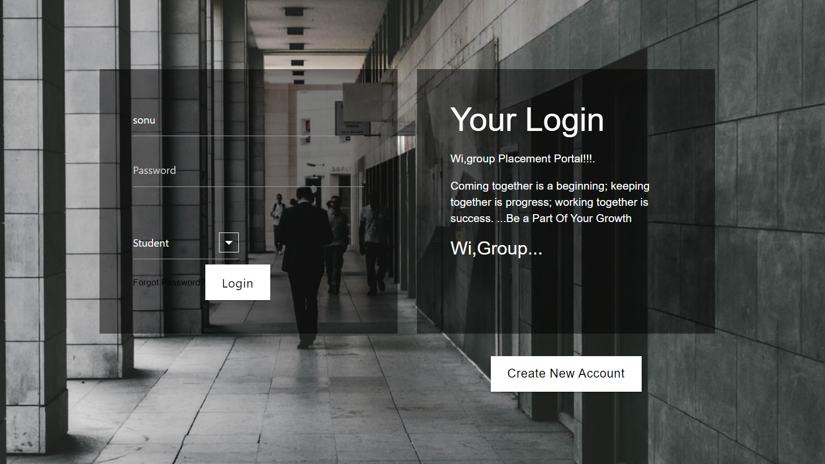
Login

Slide 13
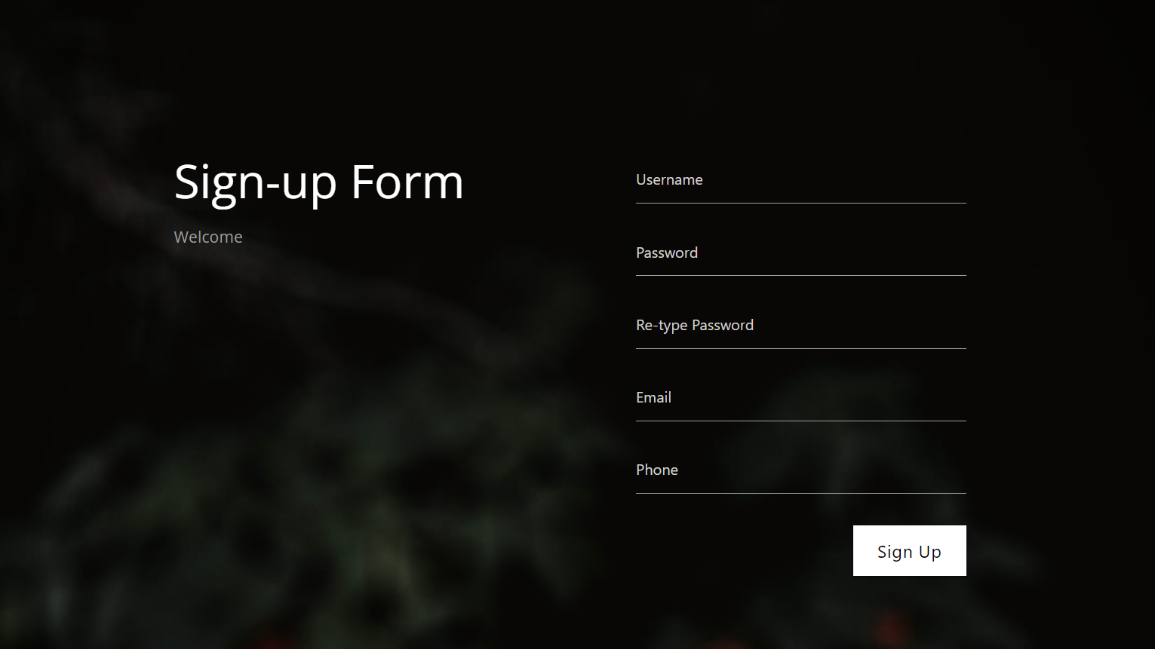
Sign Up

Slide 14
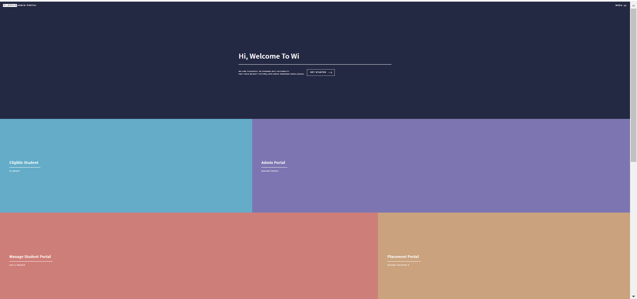
Admin Portal

Slide 15
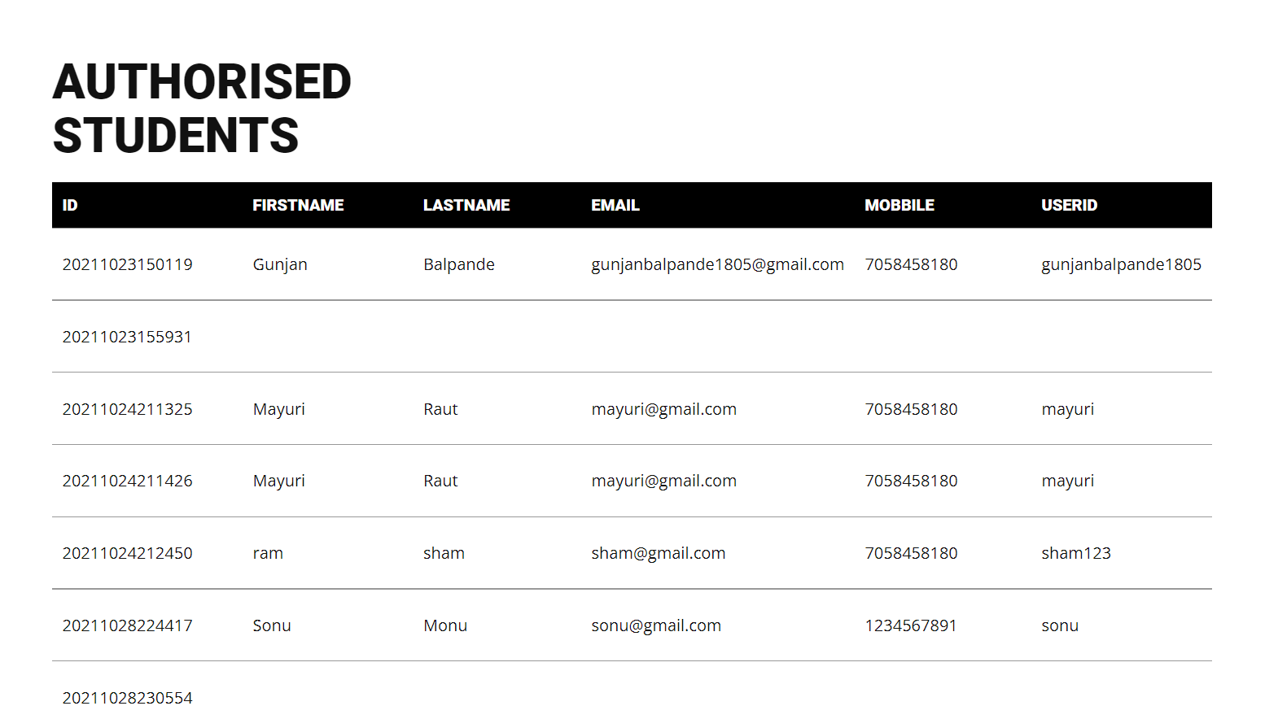
Eligible Student

Slide 16
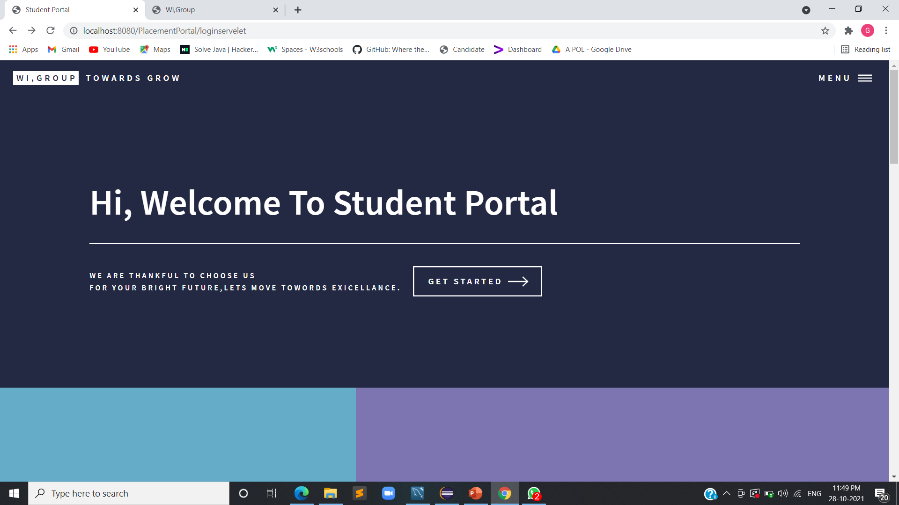
Student Portal

Slide 17
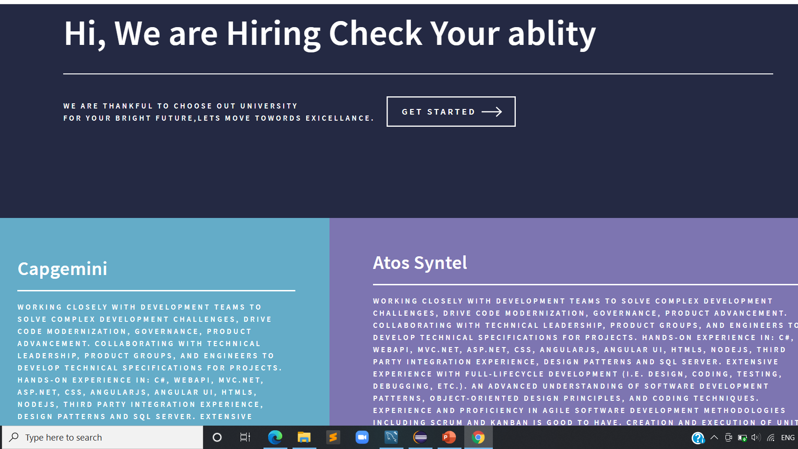
Company Details

Slide 18
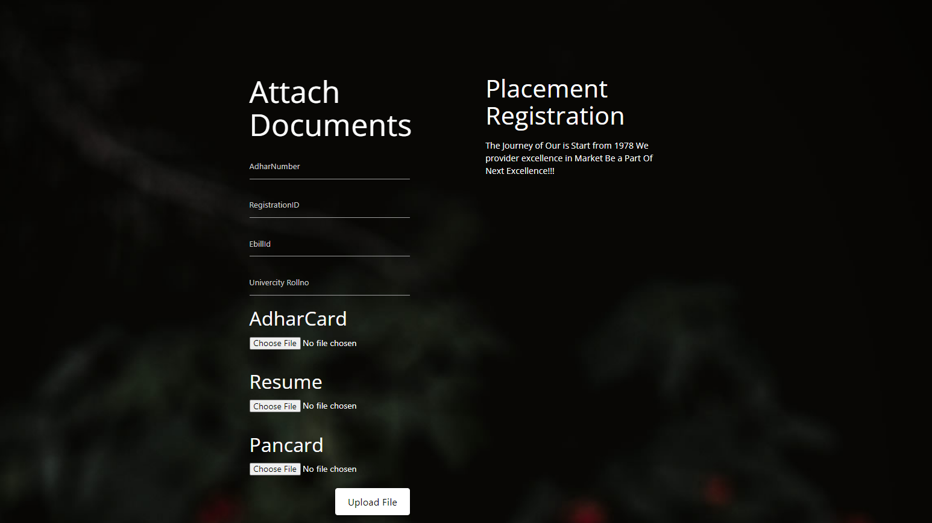
Placement Registration

Slide 19

Registration Successful

Slide 20
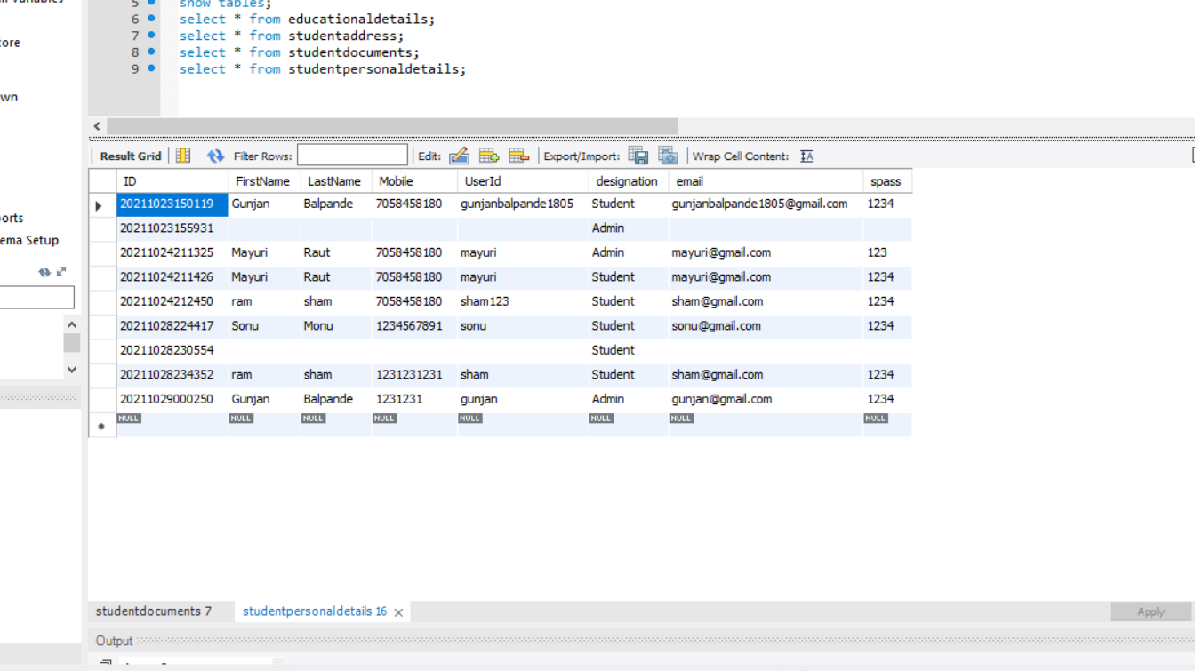
Student Personal details

Slide 21


THANK YOU

